Slide 1
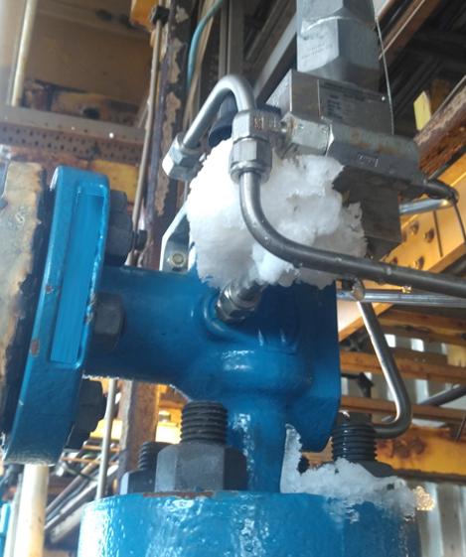
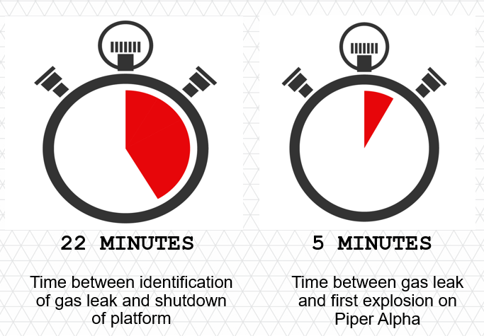
When would you shut down?
Disclaimer: this safety moment is designed to prevent similar incidents occurring. All guidance herein is provided in good faith and Step Change in Safety nor its member companies accept responsibility for any inaccuracies or omissions contained within this safety moment.

Slide 2
Timeline
CCR radios shift team leader (STL) to request attendance at site
STL returns to CCR to don PPE
STL makes way to site
STL attends site
Gas cloud presence confirmed
Faulty valve identified
(Exact timings unknown)
STL returns to CCR and requests initiation of glycol contactor flaring
Technician notices visible gas cloud on walkway
Radio call to control room (CCR) to request support
Shutdown and blow down initiated
Time
(am)
12.00
22 minutes from initial gas cloud sighting to shutdown
When would you shut down?

Slide 3
Investigation
Icing was discovered on the relief valve
Initially the gas was suspected to be coming from a component which would have meant several tonnes of gas was being released
Investigation established a different component was faulty, meaning the volume of gas released was significantly less
When would you shut down?

Slide 4



Time is critical
Think about how a similar situation might occur at your site:
If a gas leak is identified what steps are taken?
How do you know everyone is empowered to shut down the asset?
When do you make the decision to shut down?
What are the implications of delaying shutting down?
22 MINUTES
5 MINUTES
Time between identification of gas leak and shutdown of platform
Time between gas leak and first explosion on Piper Alpha
When would you shut down?

