Slide 1
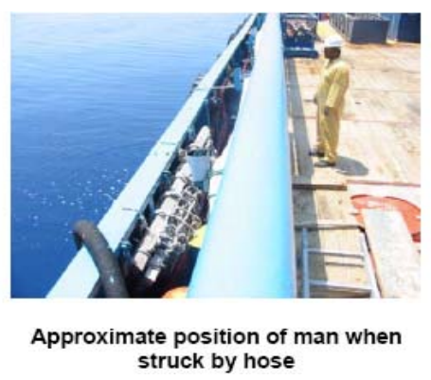
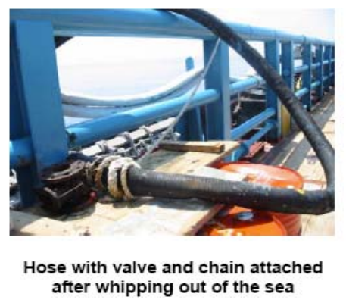
Flexible hose whipping hazard management
Flexible hoses are in use on most offshore assets but, in general, the running of hoses does not appear to be well managed. Whilst whipchecks are normally used at hose connections, sometimes they are installed incorrectly and hoses are often routed along walkways and without any intermediate restraint, increasing the threat of injury or death from hose whip.
Many are wound through or around structures, but this is insufficient to restrain a high- pressure hose that has been severed or disconnected.
Fatalities continue to occur as a result of hose whipping incidents, even on non-high pressure hoses, eg International Association of Drilling Contractors (IADC) Safety Alert 04-05.
Disclaimer: this safety moment is designed to prevent similar incidents occurring. All guidance herein is provided in good faith and Step Change in Safety nor its member companies accept responsibility for any inaccuracies or omissions contained within this safety moment.

Slide 2

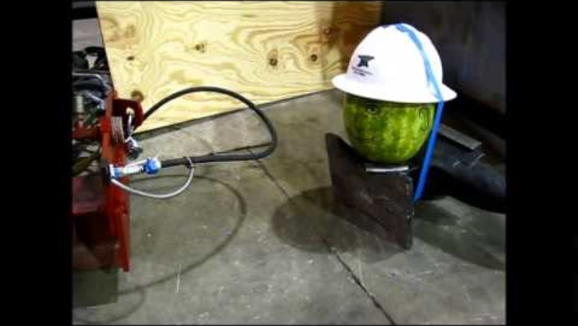
Hose whipping hazards
Video clip from American Iron Works
Whipping: Loose end(s) flail around when disconnected/ severed
Straightening : A bent hose will try to straighten when pressurized
Blow-out/projectiles
Blast overpressure: Stored energy explosion (gas hoses)
Elastic release
Fluid injection injuries: Lacerations or injection under skin
Harmful fluid contact
Thrust force: Increases with hose diameter and pressure
Liquid systems loose pressure rapidly unless pumped/accumulated
Gas/air systems can retain significant pressure and continue to flail/whip – higher risk (more than 200x greater stored energy than liquid systems with the same pressure / volume)
Video from American Iron Works
Flexible hose whipping hazard management
Notes:
Discuss potential hose whipping hazards and what can be done to prevent occurrence

Slide 3
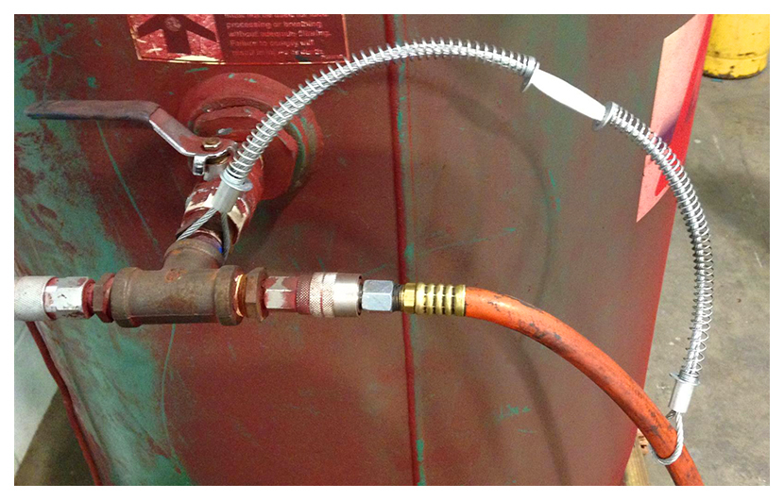
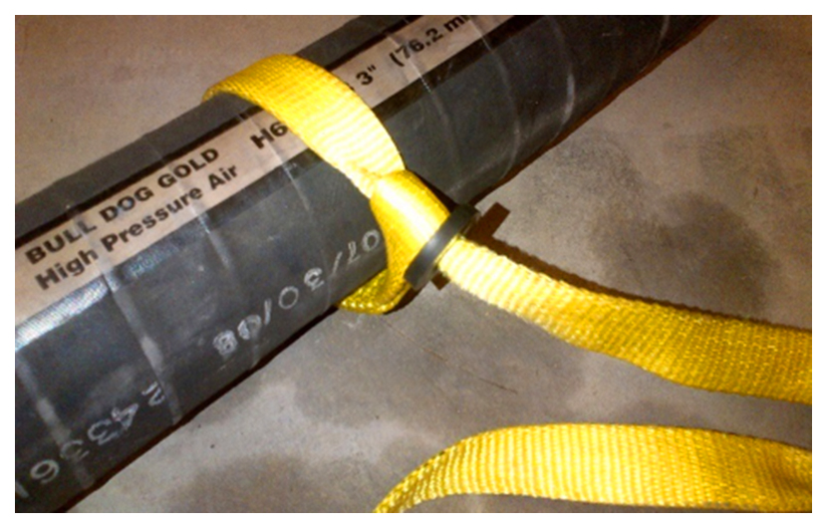
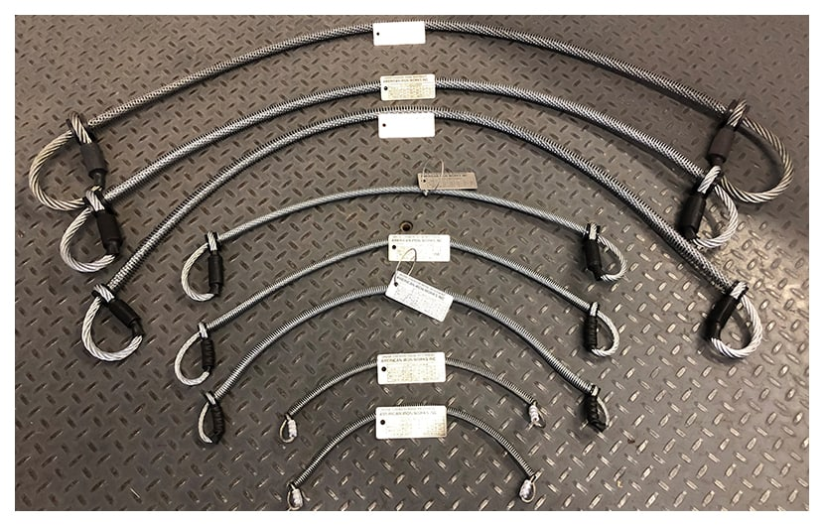
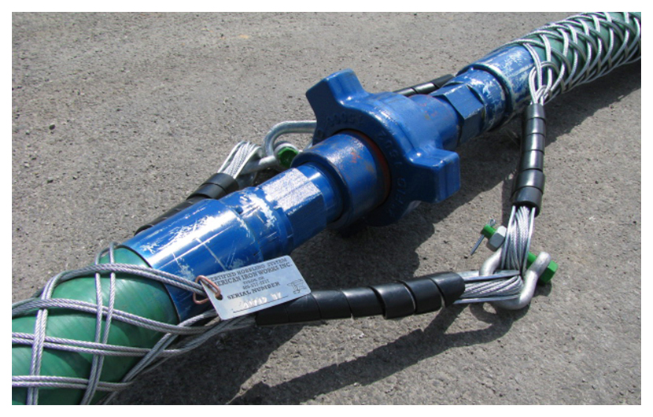
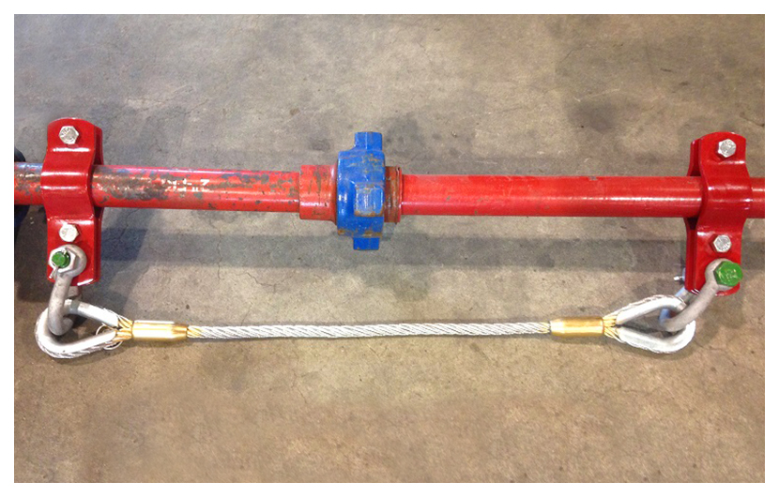
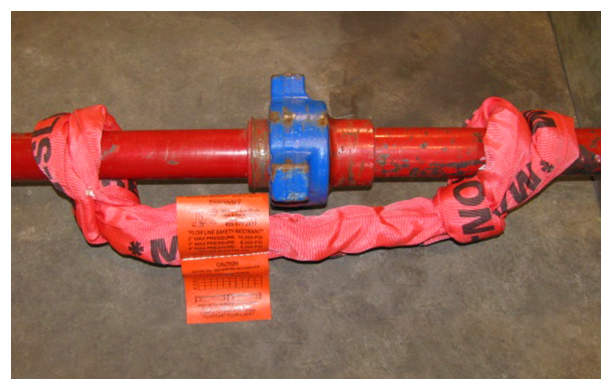
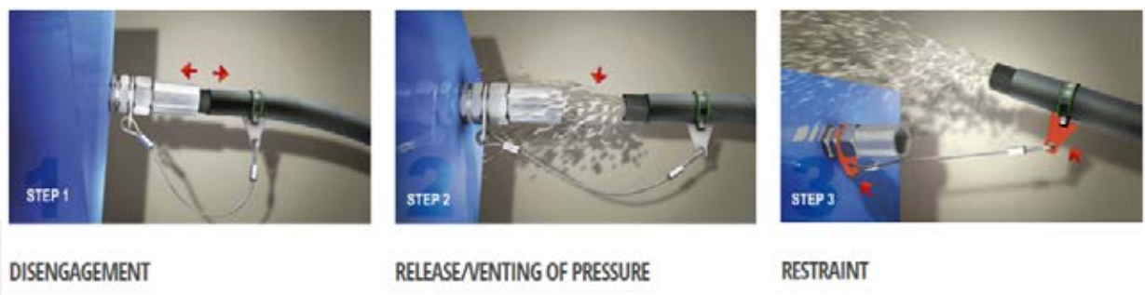
Restraint types
Restraint guidance
For all high pressure liquid hoses (>= 20 bar, #300), or air/gas hoses >= 5 barg:
Route away from pedestrian areas (avoid line of fire hazards) but otherwise should follow as straight a path as possible
Apply whipchecks at each hose-to-hose coupling
Check pressure ratings on HP hose restraints
Secure/restrain hose every 2m to minimise flail radius (clamps or whipchecks) - consider more if risk level is higher
Consider shielding/guarding if restraint is not practicable
200 PSI Whip Checks
Nylon Hose Chokers
Cable Hose Chokers
Whip Stops
Piping Hobbles
Red Iron Chokers
Images from American Iron Works & Stopflex
Flexible hose whipping hazard management
Notes:
There are several different types of hose restraints available, depending on the type, size and pressure rating of your hose.
These include:
• Whipchecks: Commonly used for small bore air hoses and for lower pressures (< 20 bar, class 150# systems)
• Cable hose choker: Stronger version of a whipcheck, used on high pressure hoses
Nylon hose choker: Used on large bore, lower pressure hoses, eg bulk transfer
Whip stops: Chinese finger grips, used on very high pressure hoses

Slide 4
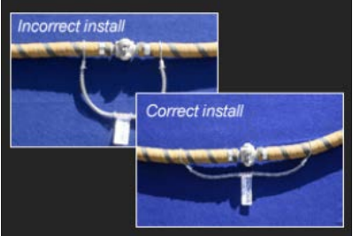
Whipcheck installation guidance
On crowsfoot connectors, check that the R-pin or other securing mechanism is installed to prevent inadvertent disconnection.
On systems that are high pressure (>= 20 bar or >= class 300#), check that the whipcheck is rated for the system pressure - labelled with safe working pressure.
Confirm that the whipcheck is in good condition and free from corrosion, damage to wire cables and that the end sleeve is free to move.
Confirm that the whipcheck is installed on the hose(s) at least 3 diameters from the end fitting rather than on the end fitting (to catch the hose if it blows off at the end fitting).
When installing at the equipment end, ensure that the whipcheck is connected to a strong metallic point that is welded or screwed in place.
Ensure that the whipcheck is extended along the hose rather than slack in a loop (to minimise shock loading on the whipcheck if the hose parts).
Image from WhipChek
Flexible hose whipping hazard management

Slide 5
Useful references
IMCA - Guidance on the Use of Whip Checks (Hose Restraints)
Health and Safety Executive – Compressed air safety (HSG39)
Energy Institute - Guidelines for the Management of Flexible Hose Assemblies
ISO/TS 17165-2:2018 - Hydraulic fluid power
IMCA – D065 Guidance on the use of whip checks (hose restraints)
Flexible hose whipping hazard management

