Slide 1
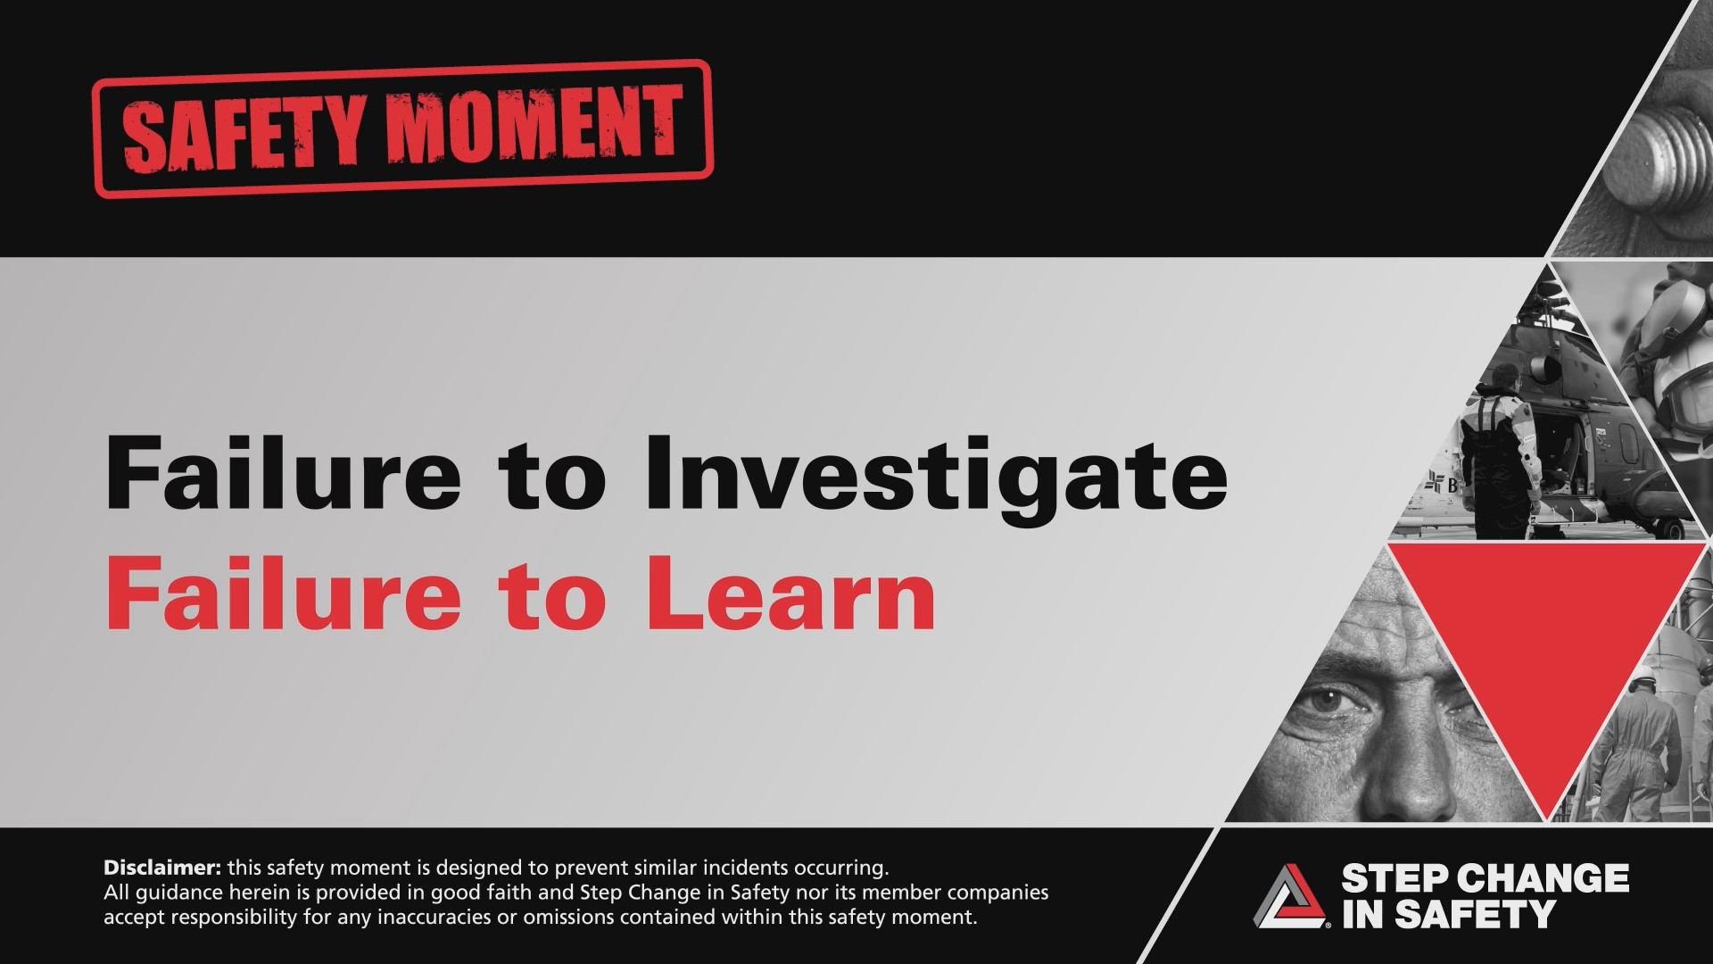
Disclaimer: this safety moment is designed to prevent similar incidents occurring. All guidance herein is provided in good faith and Step Change in Safety nor its member companies accept responsibility for any inaccuracies or omissions contained within this safety moment.

Slide 2
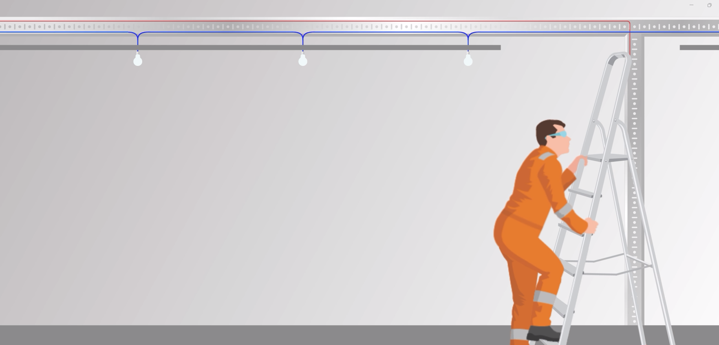
Introduction:
This Safety Moment is based on a real incident that occurred within the Telecommunications industry.
Although this incident occurred out with our industry, all learnings remain applicable.

Slide 3


Slide 4
Further Information
The Health and Safety Executive (HSE) investigated both incidents, which occurred on 1 April 2010, and found that the work was not properly assessed or planned, despite workers being exposed to such risks as working at height close to an electrical system.
The company was fined £600,000 after pleading guilty to breaching Section 2(1) of the Health and Safety at Work Act. It was also ordered to pay costs of £60,000.
A year after the accident, the first engineer returned to work, however he had lost his sense of smell and taste and required physiotherapy for a number of years. The second engineer received serious factures of the skull and spine, his sense of smell and taste has been affected, he was blinded in one eye and has long term memory problems.

