Slide 1
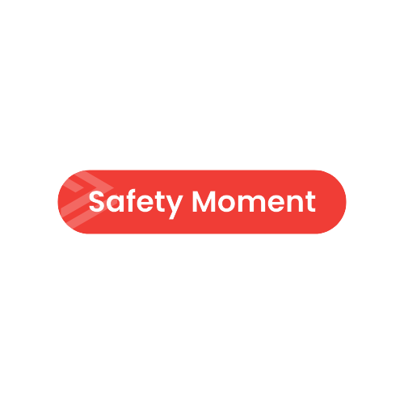
Personal Responsibility for Safety
Life Saving Rules are exactly that….. they save lives.

Slide 2
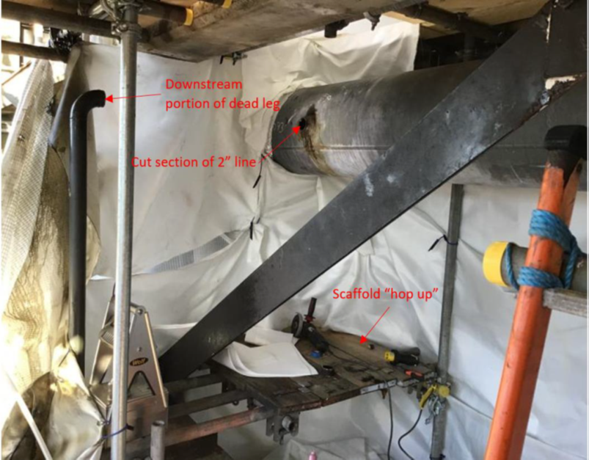
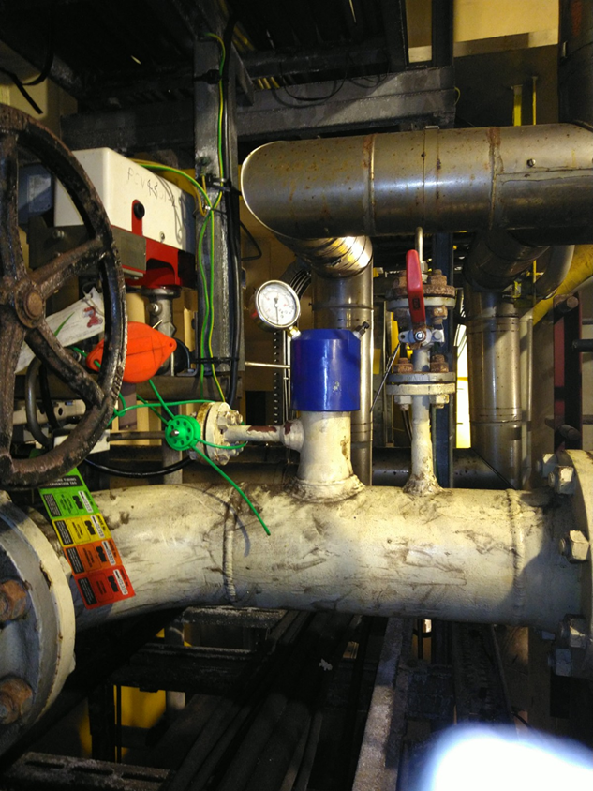
Personal Responsibility for Safety
About this Safety Moment
This pack contains two safety moments on incidents which occurred in the UKCS.
The potential consequence of these events could have been significant.
Both incidents can be used to promote the Life Saving Rules and personal responsibility for safety.
We all have a part to play.
The first one is Hot Oil…

Slide 3

Personal Responsibility for Safety
The Task
Removal of a redundant piece of 2” corroded pipe from a hot oil system.
      You have been assigned this task – what would you expect to be in place for the safe completion of it?
Notes:
-Expect to have the following controls suggested;
Safe isolation
Proving zero energy
Drained, flushed , Purged and vented.
Gas checks
Correct level of permit for the task
Dynamic risk assessment / 20 second scan
Tool box talk
Pressurised habitat
Correct tools on the permit to be used
Stop the job authority
Competent personnel
Pre use checks
Control of work requirements/expectations
Ensure identification of correct equipment (tags)

Slide 4
Personal Responsibility for Safety
System Status
The full drain, flush, purge, vent process was not carried out.
This is because the flash point of the hydrocarbon within the system was believed to be high and ignition was not thought to be a credible scenario.
N2
N₂
N₂
N₂
N₂
N₂
N₂
N₂
N₂
1. Drain
2. Flush
2. Flush
3. Purge
3. Purge
4. Vent
4. Vent
The plan is to use a grinder to remove the redundant pipe.
Does this change your assessment of the task?
Notes:
Expect people to query why the full DFPV process was not applied.
Is the use of hot work methods the safest?

Slide 5
Personal Responsibility for Safety
What went wrong?
A flammable atmosphere formed within the pipe, it was not detected and was ignited during the hot work task.
No one was seriously injured, but were understandably shaken by the event.
The hot oil system has a surge vessel which has a hydrocarbon gas blanket. This allowed entrainment of gas into the oil, which is thought to have emanated from the liquid residue to form a flammable atmosphere.

Slide 6
Personal Responsibility for Safety
Life Saving Rules
Which elements of these Life Saving Rules could have prevented this incident from occurring?
Notes:
You could also ask whether your team think this could this happen here.
What things do you have in place that would prevent this from occurring here?
How do you ensure isolations are appropriate during completion of your tasks

Slide 7
Personal Responsibility for Safety
Safety Moment 2
Assumptions are dangerous things…

Slide 8
Personal Responsibility for Safety
The Task
Removal, servicing and replacement of the corrosion coupons.
      You have been assigned this task – what would you expect to be in place for the safe completion of it?
Notes:
-Expect to have the following controls suggested;
Safe isolation
Proving zero energy
Drained, flushed , Purged and vented.
Gas checks
Correct level of permit for the task
Dynamic risk assessment / 20 second scan
Tool box talk
Correct tools on the permit to be used
Stop the job authority
Competent personnel
Ensure identification of correct equipment (tags)

Slide 9
Personal Responsibility for Safety
System Status
The installation was shut down and de-pressurised, however this part of the system was still energised.
The work party were unaware of this and did not check for zero energy.
The coupon was ejected under pressure as it was unscrewed, hitting a unistrut 2^{ft} above before landing on the scaffold access platform.
No serious injuries were sustained
1.2 Barg
Pipe Wall
Notes:
Expect people to query why the full DFPV process was not applied.
Is the use of hot work methods the safest?

Slide 10
Personal Responsibility for Safety
Life Saving Rules
Which elements of these Life Saving Rules would help prevent harm?
Notes:
You could also ask whether your team think this could this happen here.
What things do you have in place that would prevent this from occurring here?
How do you ensure isolations are appropriate during completion of your tasks

Slide 11
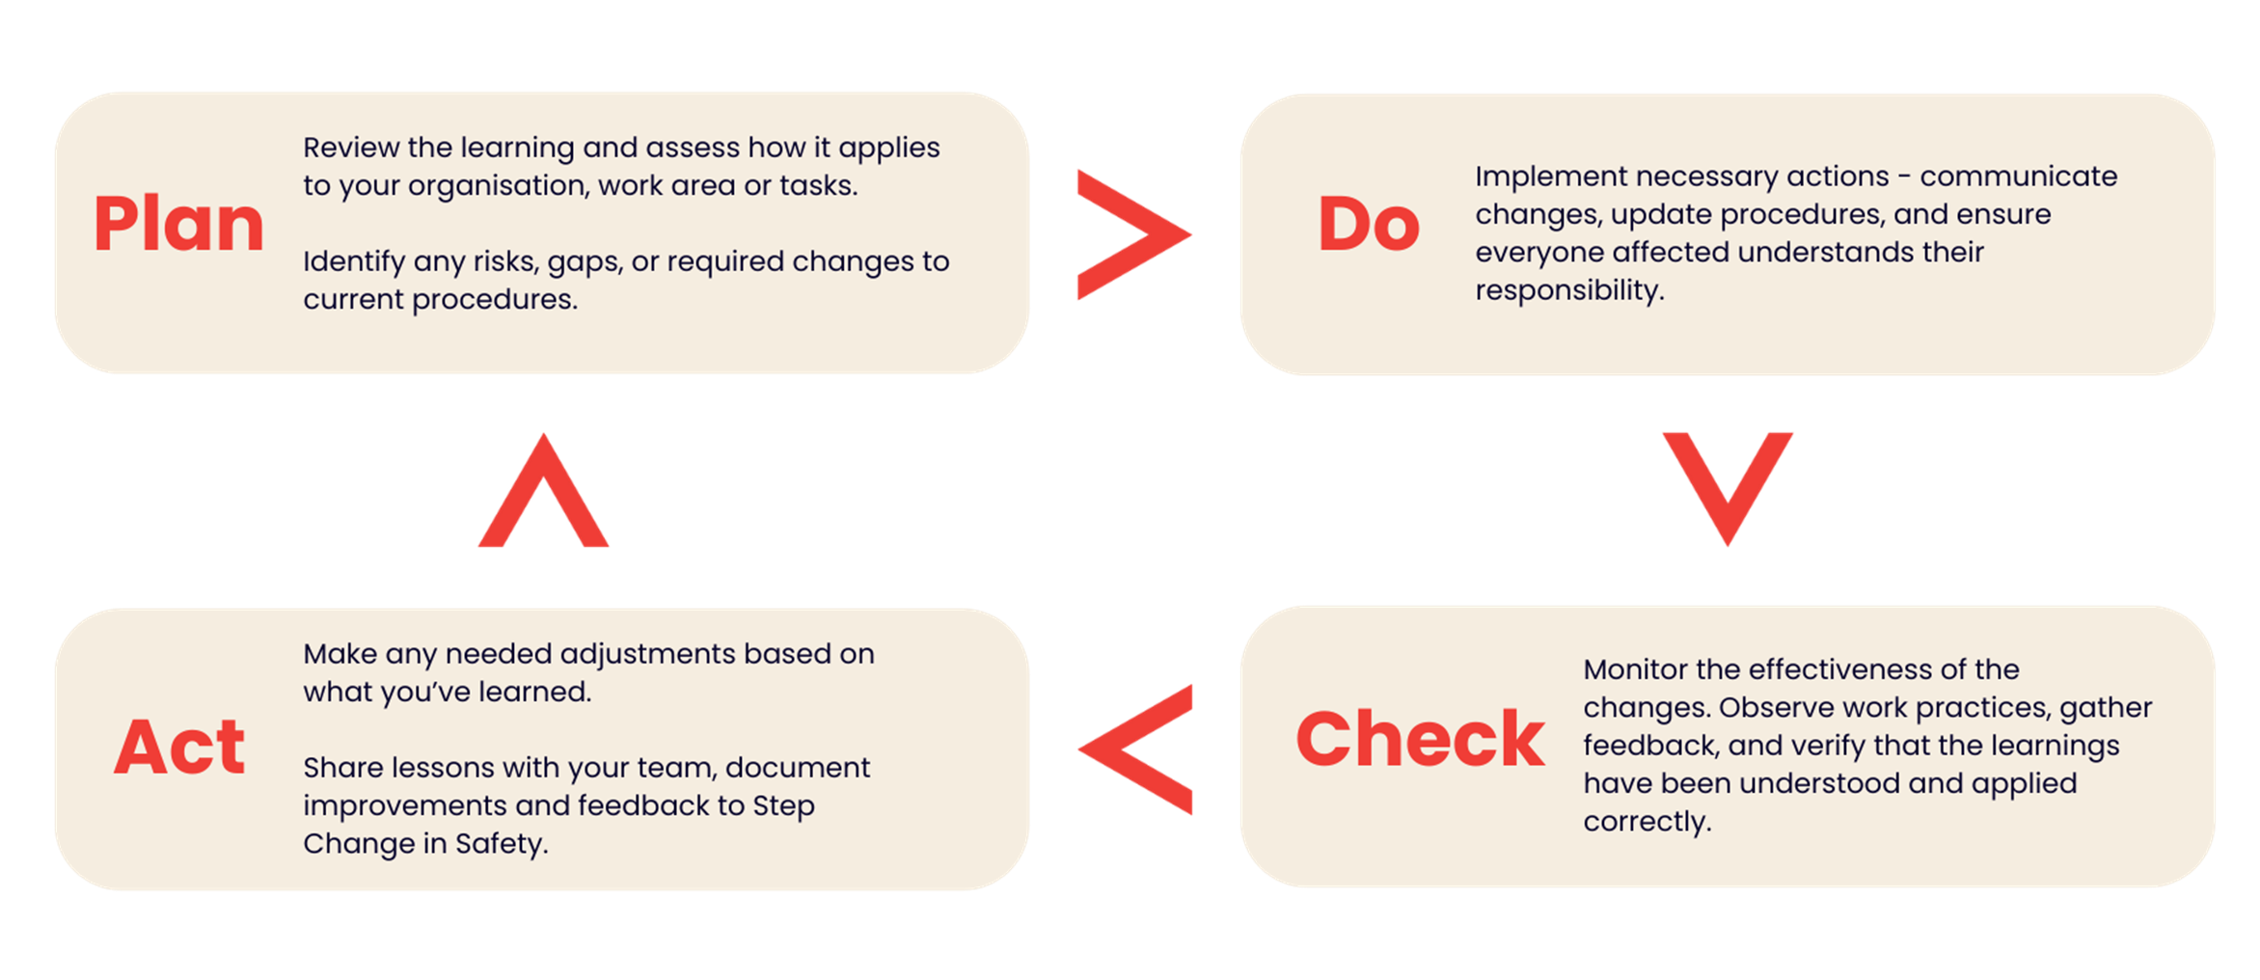
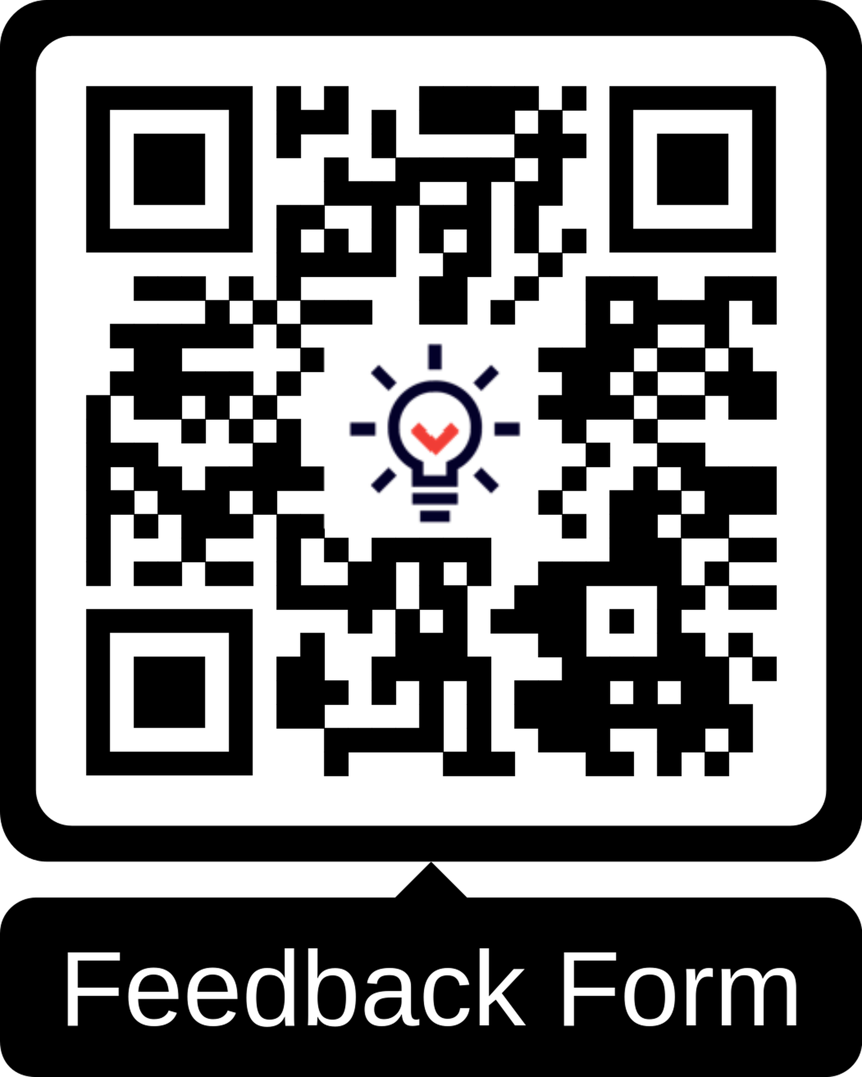
Verification of learnings shared and feedback
To ensure this learning leads to meaningful improvement, follow the Plan Do Check Act process and provide your feedback to Step Change in Safety.
Share your learnings and feedback. Your proactive engagement helps create a safer workplace for everyone.
Link to Resource Feedback Form

