Slide 1

Line of Fire – Hazards & Controls
Struck By | Caught In | Released Energy

Slide 2
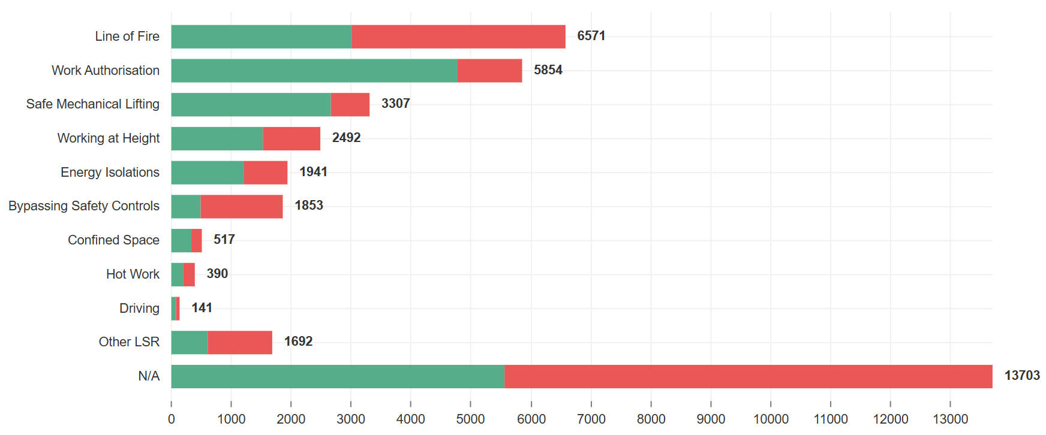


Line of Fire – Hazards & Controls
Line of Fire
Keep yourself and others out of the line of fire
Line of Fire means being in harms way; either through being caught in or between, struck by, or through released energy
A review of E-Obs* data from 2025 shows Line of Fire was a factor in 34% of the observations raised across the industry (where a Life Saving Rule was selected)
Graph 1: E-Obs industry data from Jan – Dec 2025. Shows Line of Fire as most selected Life Saving Rule (where a Life Saving Rule was selected)
Use your Toolbox Talk to ensure your team understand the hazards, the harm they can cause us, and how we can control them.
By continually Dynamically Risk Assessing our environment, we can remain spatially and situationally aware whilst identifying any new hazards that have arisen due to changes in circumstances.
We can prevent potential injuries to ourselves and colleagues by rectifying and reporting any unwanted conditions we observe. Reporting unwanted conditions allows our organisations to act on them and communicate any applicable learnings.
*E-Obs – Industry electronic observation system

Slide 3
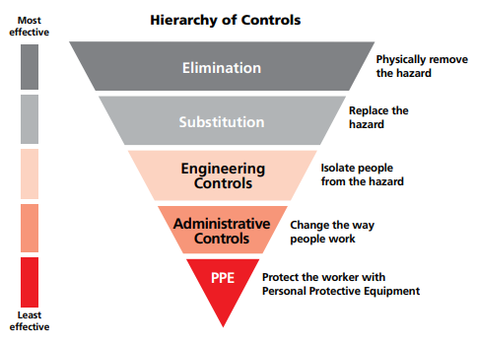
Line of Fire – Hazards & Controls
Hierarchy of Controls
The Hierarchy of Controls can be referred to, to reduce or remove hazards.
Remember – PPE is the least effective control and the last line of defense.

Slide 4

Line of Fire – Hazards & Controls
Line of Fire – Hazards & Controls
When planning work activities, it is important to consider what energy sources are involved, and what controls should be established to keep people out of the Line of Fire.
Line of Fire hazards | Examples | Controls
Caught in or between
Struck by
Released energy
Hazard
Examples
Controls
When a person is forcefully struck by an object, wherein the force of contact is provided by the object.
Vehicular movements; swinging loads; dropped objects; objects with roll potential; projectiles; lines coming under tension or parting
Push / pull poles
Tag lines
Guarding
Remove energy source
Isolations
Pressure relief and pressure monitoring systems
Safe havens
Exclusion zones
Physical barriers
Extended hand tools
Rigging
Lock out / tag out
Whip checks
When a person is crushed, pinched or caught between a moving object and a stationary object or between two moving objects.
Pressure vessel failure; boiler or combustion engine failure; hydraulic hose/fitting failure; pneumatic hose/fitting failure; differentials of pressure; electric shock; radioactive sources; heat exposure; noise exposure; light exposure
Uncontrolled or unplanned release or exposure to an energy source from equipment or a process, be it; hydraulic, pneumatic, thermal, mechanical, chemical, radioactive, electrical , etc.
Approximating surfaces; watertight doors; rotating equipment; rope bights; equipment being pushed or pulled; trench collapse
Exclusion zones
Bumper bars
Physical barriers
Secured equipment (secondary containment)
Sea fastening
Notes:
ANIMATED SLIDE Notes for presenter: This slide is intended to be shared in presentation mode as a discussion around the line of fire hazards and examples and controls for each. When ready to progress, click and the fields will be populated with the correct information. If you wish to print this slide with the populated field, the following hidden slide has been created for you to do so.

Slide 5
Line of Fire – Hazards & Controls
Line of Fire – Hazards & Controls
When planning work activities, it is important to consider what energy sources are involved, and what controls should be established to keep people out of the Line of Fire.
Line of Fire hazards | Examples | Controls
Caught in or between
Struck by
Released energy
When a person is crushed, pinched or caught between a moving object and a stationary object or between two moving objects.
Approximating surfaces; watertight doors; rotating equipment; rope bights; equipment being pushed or pulled; trench collapse
Push / pull poles
Tag lines
Guarding
Vehicular movements; swinging loads; dropped objects; objects with roll potential; projectiles; lines coming under tension or parting
Exclusion zones
Bumper bars
Physical barriers
Secured equipment (secondary containment)
Sea fastening
When a person is forcefully struck by an object, wherein the force of contact is provided by the object.
Pressure vessel failure; boiler or combustion engine failure; hydraulic hose/fitting failure; pneumatic hose/fitting failure; differentials of pressure; electric shock; radioactive sources; heat exposure; noise exposure; light exposure
Remove energy source
Isolations
Pressure relief and pressure monitoring systems
Safe havens
Exclusion zones
Physical barriers
Extended hand tools
Rigging
Lock out / tag out
Whip checks
Uncontrolled or unplanned release or exposure to an energy source from equipment or a process, be it; hydraulic, pneumatic, thermal, mechanical, chemical, radioactive, electrical , etc.
Notes:
PRINT OUT

Slide 6
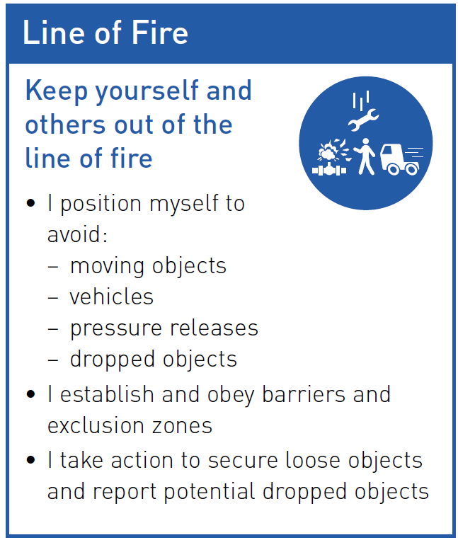
Line of Fire – Hazards & Controls
Life Saving Rule - Line of Fire
Discuss how the Line of Fire rule could have been used to prevent the following incidents from happening.
Notes:
PRINT OUT

Slide 7
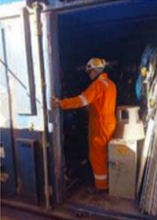
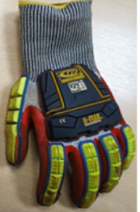

Line of Fire – Hazards & Controls
Caught in or between - Container door closed injuring hand
A gust of wind blew a container door shut on a workers hand, causing bruising and swelling.
The task was for an individual to transfer materials between storage containers.
The doors to the storage container were already open when the IP arrived to unload the materials.
As the IP was exiting the container, they grabbed hold of the door frame and at this point, a gust of wind blew the door shut against the IP’s hand
The IP reported to the Medic and was medivac’d to the local hospital for further assessment. where it was confirmed there were no breaks or open wounds, only bruising and slight swelling. The injuries could have been a lot more serious had the IP not been wearing their PPE.
Download full Safety Alert here
Additional Safety alerts – caught in or between
Shifting of centre-of-gravity of load LTI Finger crush whilst operating safety gate Two hand injuries Restricted work case classification finger injury LTI Fingertip pinched by wire sling Serious hand injury during mooring operations Finger injury while setting up pipe cutting operation Caught between: unplanned movement of equipment leads to severe injuries Line of fire driving Container door closed injuring hand Hand injury whilst using portable hand grinder
Download additional Caught in or between alerts as a pack
Notes:
PRINT OUT

Slide 8
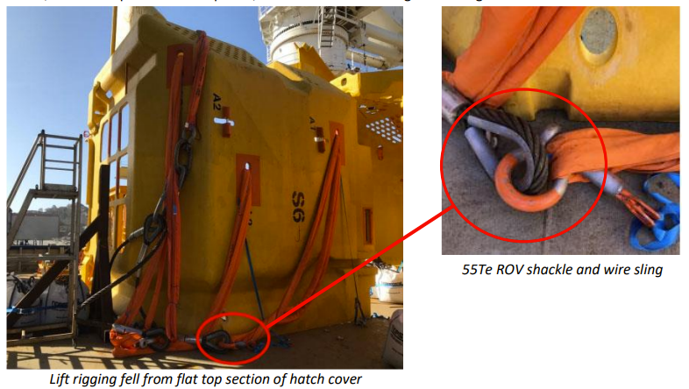

Line of Fire – Hazards & Controls
Struck by- Person struck in rigging accident
During the loading of subsea hatch covers onto a vessel, a member of the rigging crew was struck and badly injured by a 55 Te shackle connected to a steel wire sling and fibre lifting sling,
The hatch cover was safely landed on deck. However, during the lowering of the lift rigging to enable the crane to be disconnected, a slack leg of the lifting bridle, which would only come into use during deployment subsea, came to rest on the top flat section of the hatch cover.
Instructions were given by the banksman to ‘stand by’ whilst the crane maneuvered to free and lower the slings to deck. The volume on the injured person’s radio had previously been turned down due to feedback from other users’ radios, and subsequently missed the safety command from the banksman.
The rigger approached the load and within 5 seconds of doing so the rigging suddenly fell from the top of the cover and struck him. The rigger sustained multiple injuries including a fractured and dislocated right clavicle, fractured spine in several places, broken ribs and bruising to the lung.
Download full IMCA Safety Alert here
Additional Safety alerts – struck by
Forklift knocked spooler bar onto persons leg Diver in the bell hit by falling object LTI worker fractured arm during mooring line handling UK HSE: worker struck in the face by a-crane hook Head injury due to windsock mast failure Sudden ice plug release results in struck by injury
Download additional Struck by alerts as a pack
Notes:
PRINT OUT

Slide 9
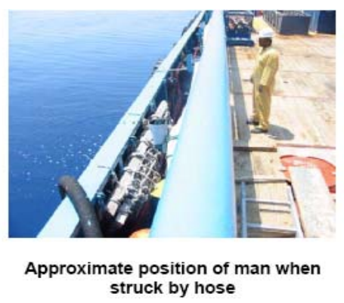
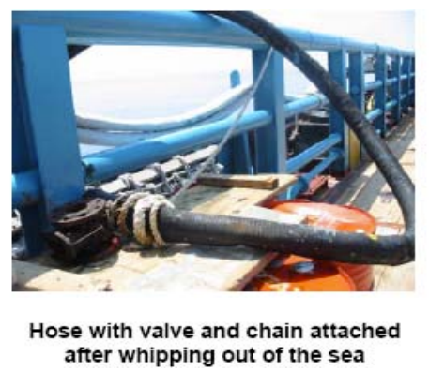

Line of Fire – Hazards & Controls
Released energy – Fatal accident involving a flexible hose
A supply boat crewman was struck on the head by a flexible hose during pressure venting after transfer of bulk drilling chemicals.
Transfer of bulk drilling chemicals used compressed air at a low pressure. On transfer completion, instructions were given to close all valves, purge and depressurize the transfer lines and disconnect the bulk transfer hose.
The 4" diameter flexible vent hose was lowered over the starboard side of the vessel into the sea to prevent dust clouds during venting. To keep the hose submerged an old valve and ballast chain had been secured to its outboard end. A length of rope was tied between the outboard hose end and the vessel rail to allow for hose recovery, leaving about a 4m arc of movement between secured points.
Upon opening the vent valve in the engine room there was a sudden release of compressed air causing the vent hose to whip out of the sea onto the deck of the vessel.
Download full IADC Safety Alert here
Additional Safety alerts – released energy
Person injured going down ladder LTI fingers injured during fender lifting operation LTI gangway collapsed LTI partial thickness burns from cooling water Electrocution incident make sure electrical equipment is safe Employee fell into the cable pit Pressure release after ice plug removal results in injury Electrician suffered flash burn to hand
Download additional Released energy alerts as a pack
Notes:
PRINT OUT

Slide 10
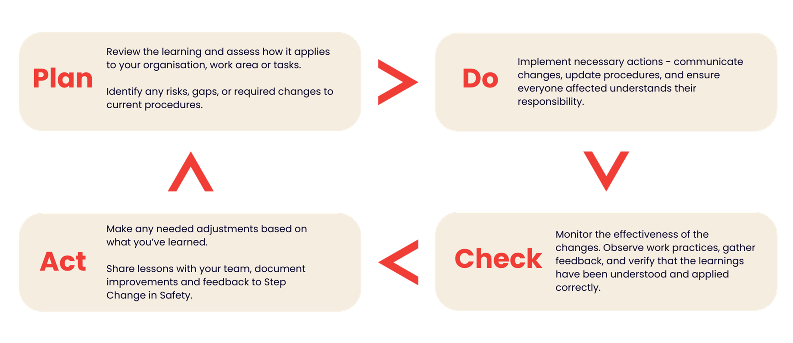

Verification of learnings shared and feedback
To ensure this learning leads to meaningful improvement, follow the Plan Do Check Act process and provide your feedback to Step Change in Safety.
Share your learnings and feedback. Your proactive engagement helps create a safer workplace for everyone.
Link to Resource Feedback Form

