Slide 1
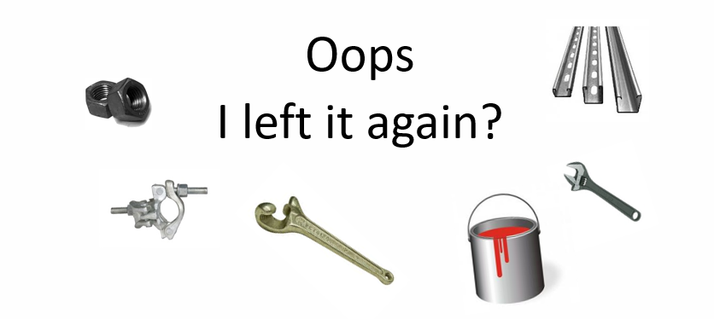
Prevention of Dropped Objects
Photo Credit: Jan Berghuis
Disclaimer: this safety moment is designed to prevent similar incidents occurring. All guidance herein is provided in good faith and Step Change in Safety nor its member companies accept responsibility for any inaccuracies or omissions contained within this safety moment.

Slide 2



Prevention of dropped objects
Did you know?
Dropped objects;
are 1 of the 3 most common causes of fatalities and serious injuries within many industrial sector
are a serious threat in leisure and homelife too
can occur anywhere at any time
Dropped Objects – Static and Dynamic
Use your Toolbox Talk to ensure your team understand the hazards, the harm they can cause us, and how we can control them.
By continually Dynamically Risk Assessing our environment, we can remain spatially and situationally aware whilst identifying any new hazards that have arisen due to changes in circumstances.
We can prevent potential injuries to ourselves and colleagues by rectifying and reporting any unwanted conditions we observe.
Reporting dropped objects or objects with the potential to become a dropped object allows our organisations to act on them and communicate any applicable learnings.
Access interactive version of this film here
Prevention of dropped object

Slide 3
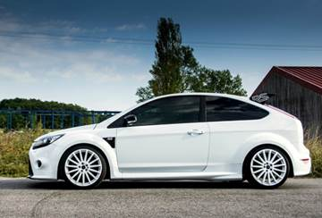
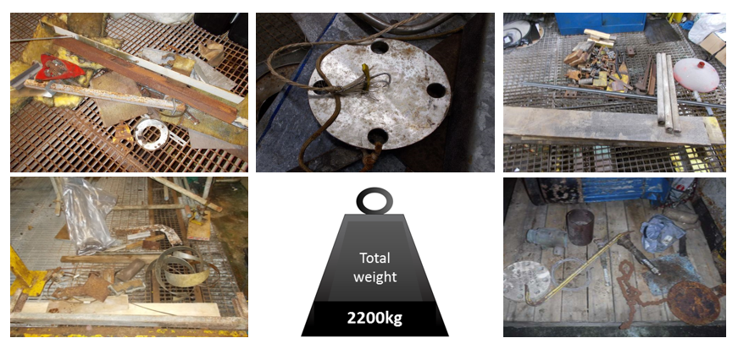

Dropped objects affect every stage of a facilities life cycle.
Particular attention should be paid during times of change, e.g. construction, shutdowns, modifications, following severe weather events, decommissioning and in areas of infrequent use.
These items were found during one platform clean-up campaign in 2016 and were all potential dropped objects:
The combined weight of the loose items removed is the same as the combined weight of these two cars.
= 2.2 tonnes
When did we last do a sweep of our location?
Are worksites in a tidy condition when we start work?
When we finish a job, do we always clear up? If not, what prevents us?
What methods of secondary retention are used at site?
What can we do to prevent dropped objects?
Prevention of dropped objects

Slide 4

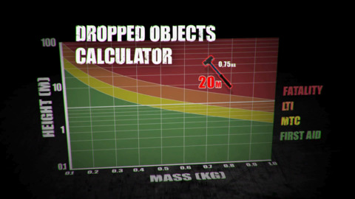

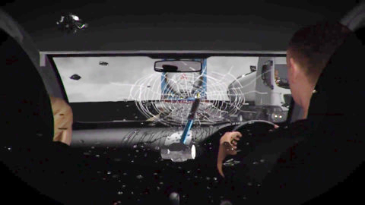
USEFUL LINKS
-Static Dropped object Case study (interactive film with questions)
-Dynamic Dropped Object Case study (interactive film with questions)
Prevention of dropped objects

